Slide 1
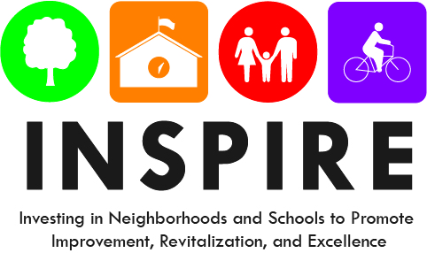
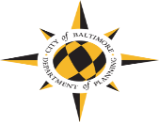
John Ruhrah Elementary/Middle School
Draft Recommendation Report
PTO Meeting – November 20, 2019

Slide 2
Investing in Schools + Neighborhoods
City Schools, Maryland Stadium Authority, Baltimore City, and the State are investing nearly one billion dollars to renovate or replace schools.
21st Century has 3 goals:
Transform student opportunities and achievement
Improve engagement and wellbeing of communities
Help revitalize neighborhoods and communities
The Planning Department launched the INSPIRE program to focus on the neighborhood immediately surrounding each of the 21st Century schools.
Concentrate improvements around the school:
Improve the environment and quality of life
Take concrete action towards the community’s long-term vision; guide private investment
Notes:
21st Century was in place - many people recognized importance of using the investments and momentum around the schools to catalyze other positive neighborhood changes.
That’s how DOP came to launch INSPIRE (which stands for Investing in Neighborhoods and Schools to Promote Improvement Revitalization and Excellence).
INSPIRE is a process that results in a plan that is adopted by the Planning Commission. Like other plans, the bulk of the document is a series of recommendations that focus on improvements in the environment and QOL of students, their families, and neighborhood residents and businesses.
INSPIRE does not focus on a large area. It focuses primarily on the ¼-mile around each of the 21st Century schools.

Slide 3
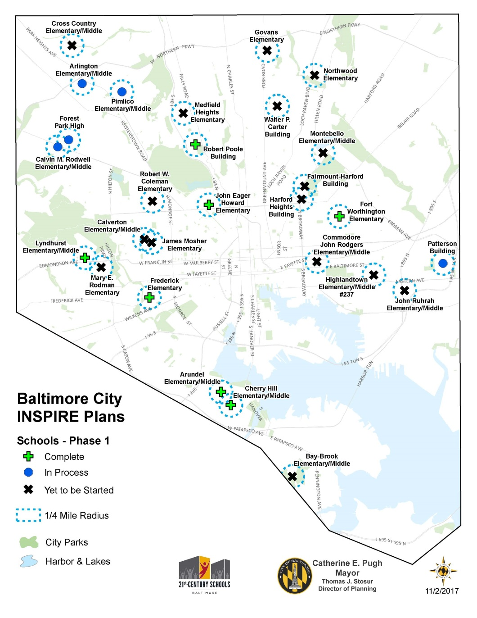
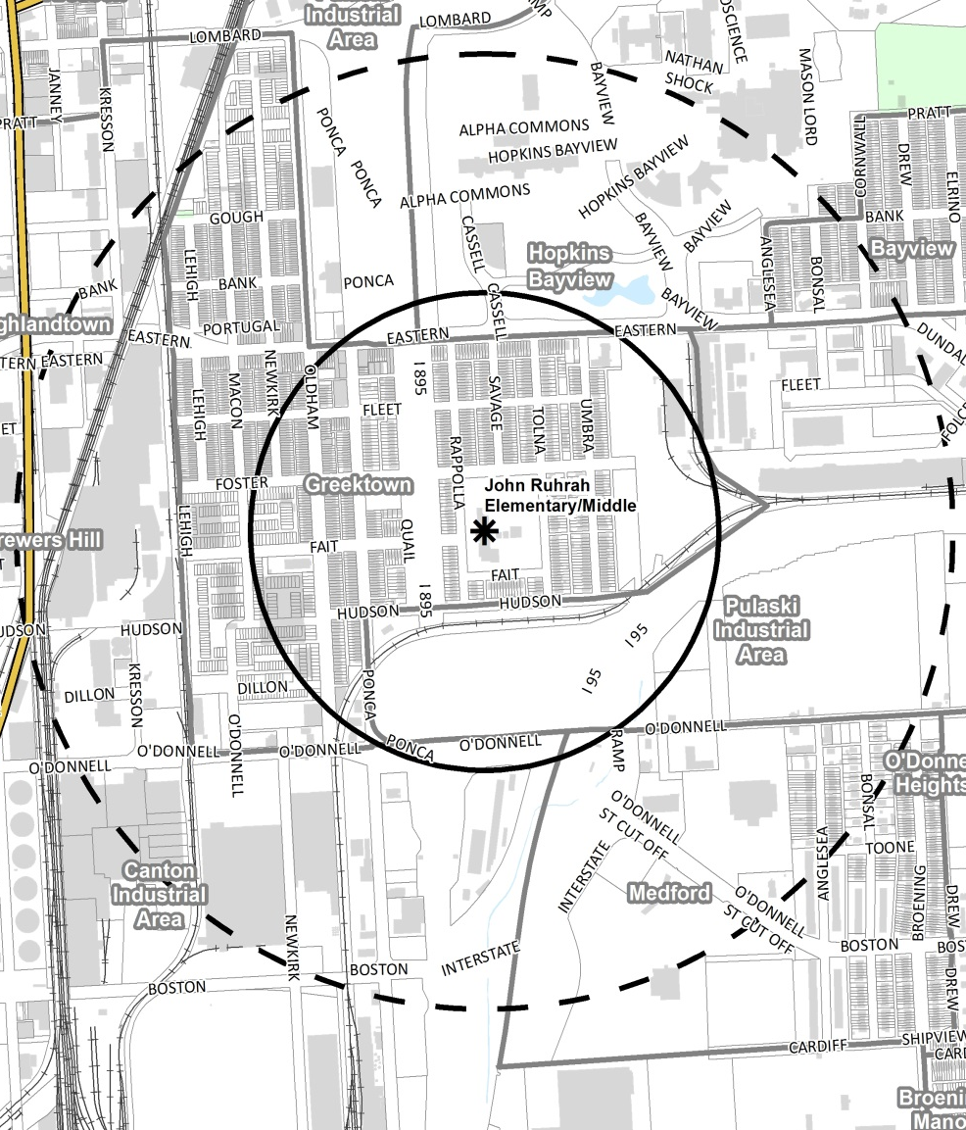
INSPIRE Citywide and at John Ruhrah
Notes:
Where there’s a substantial school renovation happening through 21st Century, we’ll be working on INSPIRE. 23-28 schools – throughout the city.
John Ruhrah Elementary/Middle School*
Anticipated occupancy:
Modernization: Rehabilitation and Addition
Future student grades: PK-8
Current capacity: 421 students/113%
Future capacity: ~807 students/90%
* Data according to 21st Century

Slide 4
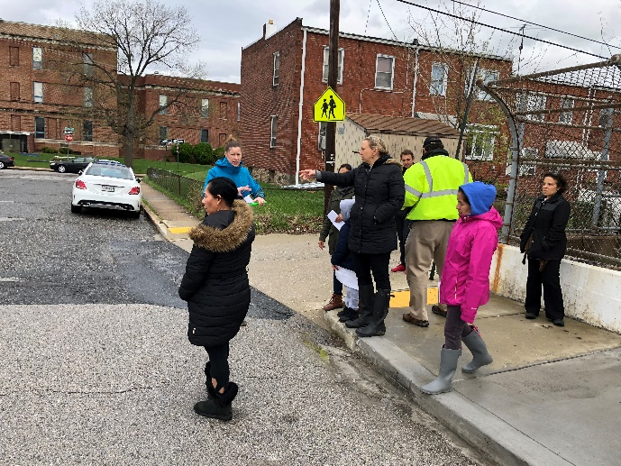
Where We Are in the Process
LISTEN: GATHER INFORMATION
CREATE: DRAFT & REVIEW RECOMMENDATIONS
DELIVER: FINALIZE & IMPLEMENT PLAN
Workshops, Surveys, “Field work” (community walks)
DOP Drafts, City Agency Involvement, Steering Committee Involvement, Workshops
DOP Finalizes , Present to Planning Commission,
COMMUNITY ENGAGEMENT
INSPIRE School Focus Groups
GGNA Community Meetings
PTO Meetings
INSPIRE Surveys
School Events
Fieldwork – Community Walks
Business Canvassing
City Agencies Meetings

Slide 5
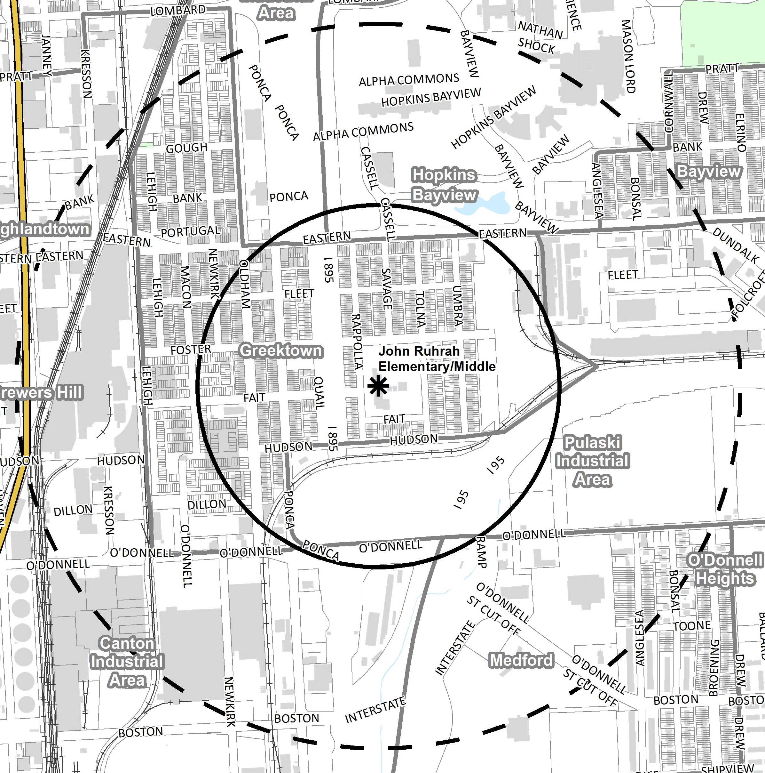
John Ruhrah INSPIRE Plan Area
Primary focus: ¼ mile around school
Broader focus: Greektown Neighborhood
Notes:
Where there’s a substantial school renovation happening through 21st Century, we’ll be working on INSPIRE. 23-28 schools – throughout the city.
John Ruhrah Elementary/Middle School*
Anticipated occupancy:
Modernization: Rehabilitation and Addition
Future student grades: PK-8
Current capacity: 421 students/113%
Future capacity: ~807 students/90%
* Data according to 21st Century

Slide 6
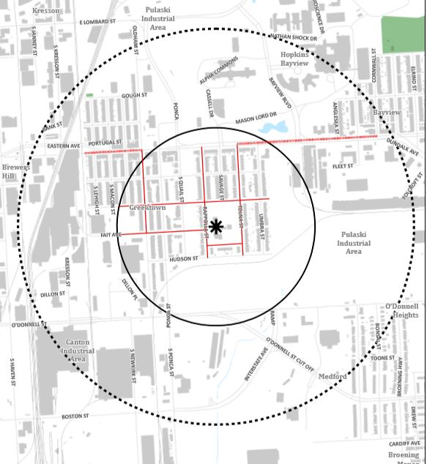
Recommendations: Primary Walking Routes
Preparing for Opening Day City agencies have committed to making these improvements:
Repairing sidewalks
Repainting or adding crosswalks
Marking Safe Routes to School
Assessing crossing guard deployment
Pruning & planting street trees
Replacing missing/broken lights
Boarding open vacant buildings
Picking up trash and maintaining vacant lots
Notes:
One set of recommendations focuses on physical improvements along designated walking routes. These are the standard improvements that will be the same across all of the areas, and that will be made prior to opening day of the modernized school. Paid for with INSPIRE bonds and City agency capital budget.
The routes are developed with input from principals, community school coordinators, teachers, students, parents, community members, crossing guards, and SR2S. ID the major routes children take to get to school, paying particular attention also to where students previously zoned for a closing school will be coming from.

Slide 7
Area-Specific Recommendations
Invest in Housing & Market-Strengthening Opportunities
Create Environmentally-Sustainable & Clean Neighborhoods
Create Connections & Access
Create Opportunities for Health & Wellness
Improve Public Safety
Promote Opportunities for Wealth Building & Economic Development

Slide 8
Recommendations: 1/4-Mile around the School
1. Invest in Housing & Market Strengthtening Opportunities:
Target Homeownership Opportunities and Improve Homes
Market homeownership opportunities
Homeownership assistance programs
Connect homeowners with legal assistance
Enhance Code Enforcement
Partnership with HCD to clean-up the blocks in the INSPIRE area
Promote Strategic Redevelopment Opportunities and Encourage Business Partnerships with the Community
Façade improvements for businesses along Eastern Avenue
Connect Hispanic/Latino-owned small businesses with BDC services
Community input in the redevelopment of the Crown Cork and Seal Property
Update community on the PEMCO-Yard 56 development
2. Improve Safety:
Continue to work with the Southeastern Police District
Develop community-driven strategy to address crime and drug addiction
GGNA should continue to work with the Liquor Board Inspectors, and explore other ways to address health and noise concerns around alcohol-selling establishments
Notes:
General categories: Process will lift up priorities in the Brooklyn and Curtis Bay communities around the school.

Slide 9
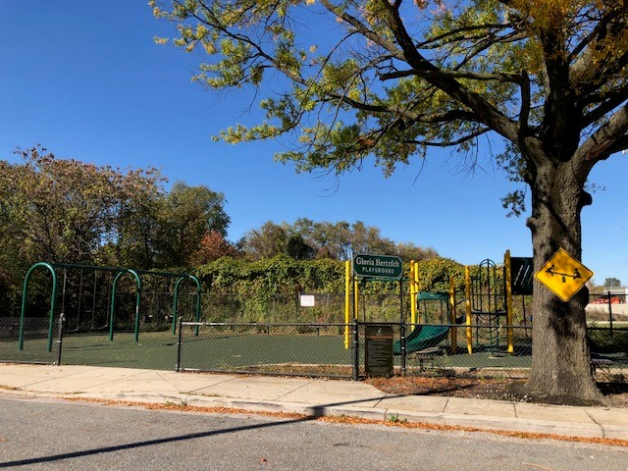
Recommendations: 1/4-Mile around the School
3. Create Connectivity and access:
Improve Walkability, Pedestrian Safety, and Access in the Neighborhood
Explore traffic calming mechanisms
Implement Complete Streets on Eastern Avenue
Improve the safety for pedestrians at the major intersections
Improve the I 895 overpasses
Increase safety of students walking and biking to school
Improve lighting around the school
4. Create Opportunities for Health and Wellness
Continue Community Engagement to Improve Social Connections and Use of Recreational Opportunities
a. Expand and improve the Lehigh Playground
Notes:
General categories: Process will lift up priorities in the Brooklyn and Curtis Bay communities around the school.

Slide 10
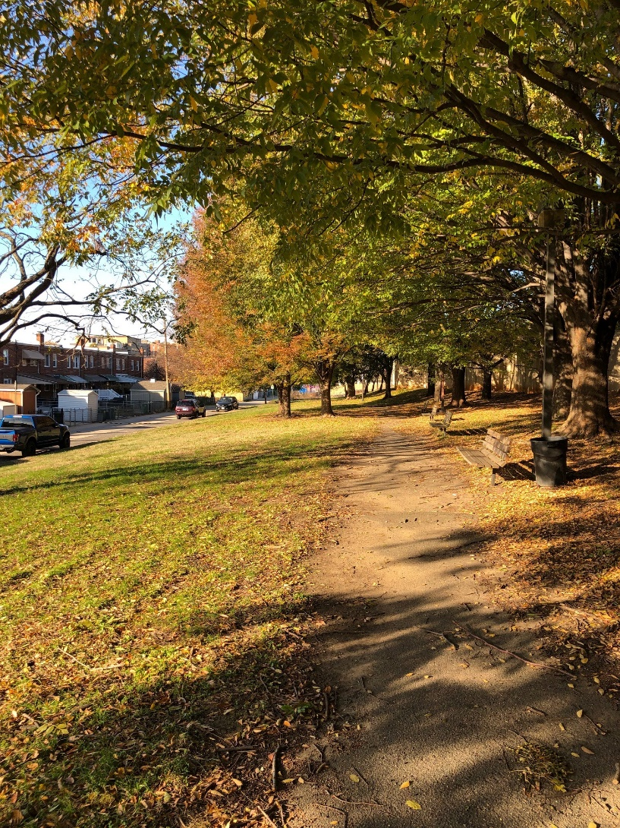
Recommendation for Community-Selected Priority Project: Umbra Street Park Placemaking Project
Creating a landscaped pedestrian entrance
Maintaining existing landscaping
Upgrading pedestrian lighting
Installing ADA-accessible pathways and benches
Creating a mural along the highway dividing wall
Notes:
General categories: Process will lift up priorities in the Brooklyn and Curtis Bay communities around the school.

Slide 11
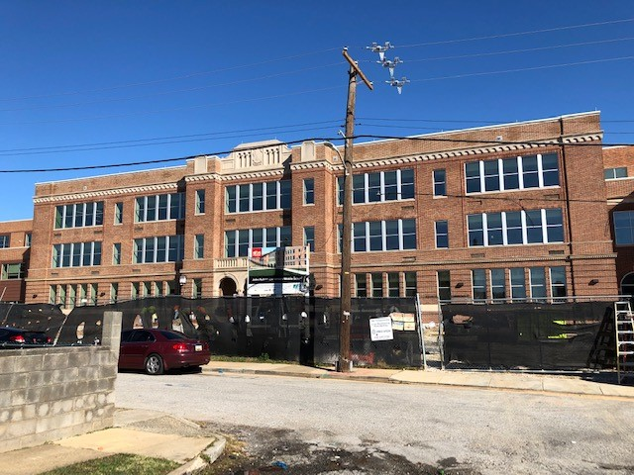
Recommendations: 1/4-Mile around the School
5. Create an Environmentally-Sustainable Neighborhood:
Create a Clean and Green Community
Develop and implement an educational campaign and a dog-waste bag dispenser program
Advocate to the property owner to improve the vacant green space along Hudson Street
Create positive, multilingual signs throughout the neighborhood.
John Ruhrah to be certified as a Sustainable Maryland Association for Environmental and Outdoor Education (MAEOE) Green School
Increase the tree canopy
Notes:
General categories: Process will lift up priorities in the Brooklyn and Curtis Bay communities around the school.

Slide 12
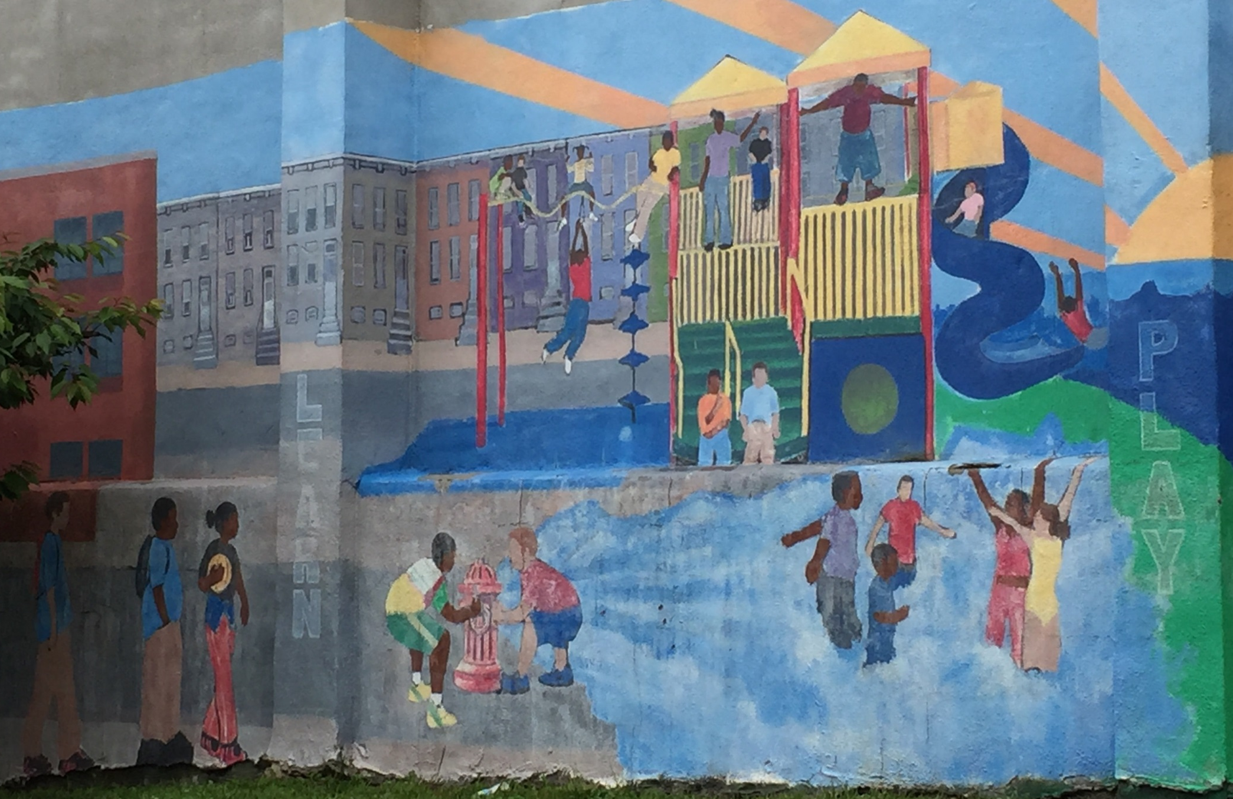
Comments
Carmen Morosan Northeast District Planner
443.984.4000
carmen.morosan@baltimorecity.gov
Mary Colleen Buettner
City Planner, INSPIRE
410.396.5937
mc.buettner@baltimorecity.gov
Website: https://planning.baltimorecity.gov/inspire-plans/john-rurah-elementary-middle-school

